Slide 1

Bluetooth controlled RC with Auto brake System (BCRCABS)
Mohamed Mohy Akl 120210268
Ahmed Mahmoud Abdelazim 120210274
Zyad Tarek Omar 120210275
Yahia Ali Othman 120210302

Slide 2
Project Description
Our project is Bluetooth controlled RC with Auto brake System in which The RC has two IR sensor one in front and the other in the back these sensors helps us to detect whether there is an obstacle or not . If there is one a LED and bazar turn on and off and the RC take the opposite direction of the obstacle if there is one in front it moves back and vice versa . We use HC-05 Bluetooth Module to control the RC using UART protocol .

Slide 3
Design
Arduino
HC-05 Bluetooth Module
IR Reflective Sensor
L298N motor driver
DC motors
Bazar
LED
Resistor
Breadboard
Battery

Slide 4
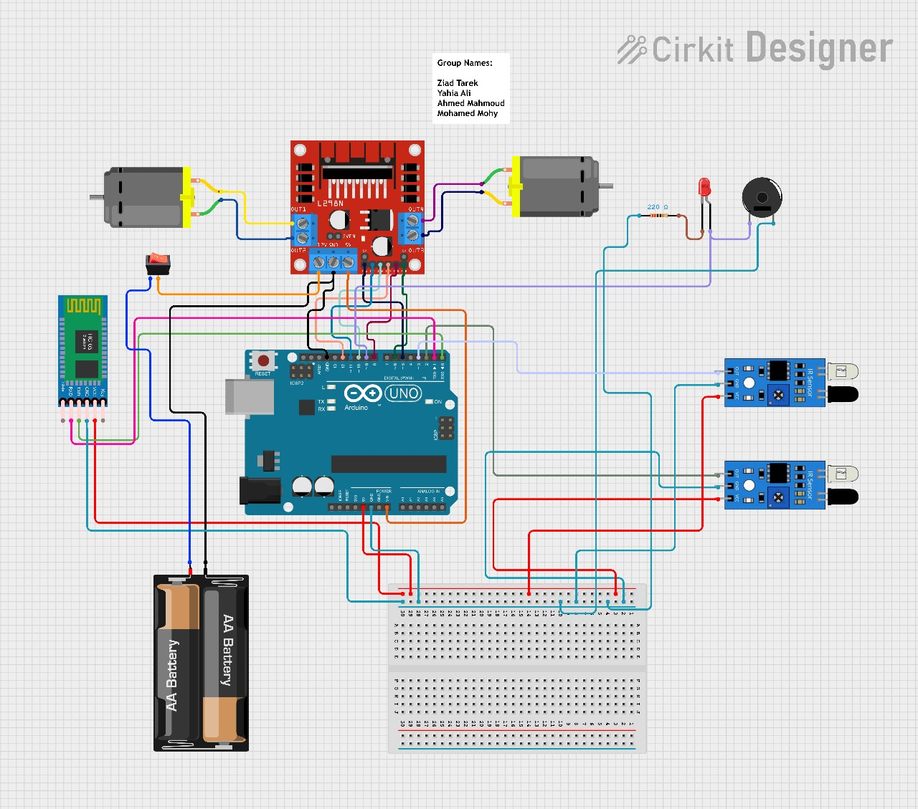

Slide 5
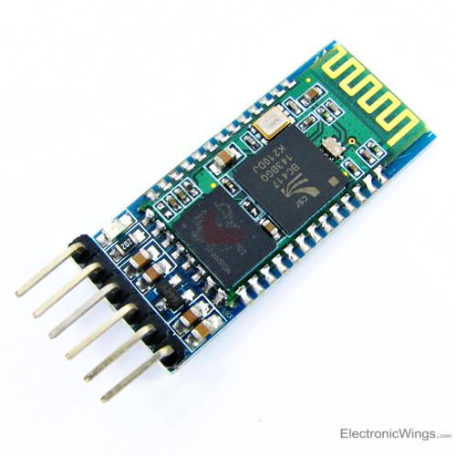
HC-05 Bluetooth Module
1. Key/EN: It is used to bring Bluetooth module in AT commands mode. If Key/EN pin is set to high, then this module will work in command mode. Otherwise by default it is in data mode. The default baud rate of HC-05 in command mode is 38400bps and 9600 in data mode.
HC-05 module has two modes,
1. Data mode: Exchange of data between devices.
2. Command mode: It uses AT commands which are used to change setting of HC-05. To send these commands to module serial (USART) port is used.
2. VCC : Connect 5 V or 3.3 V to this Pin.
3. GND: Ground Pin of module.
4. TXD: Transmit Serial data (wirelessly received data by Bluetooth module transmitted out serially on TXD pin)
5. RXD: Receive data serially (received data will be transmitted wirelessly by Bluetooth module).
6. State: It tells whether module is connected or not.

Slide 6
HC-05 Bluetooth Module
How it Works?!!
The HC-05 is a class 2 Bluetooth module designed for transparent wireless serial communication. It is pre-configured as a slave Bluetooth device. Once it is paired to a master Bluetooth device such as PC, smart phones and tablet, its operation becomes transparent to the user. All data received through the serial input is immediately transmitted over the air. When the module receives wireless data, it is sent out through the serial interface exactly at it is received. No user code specific to the Bluetooth module is needed at all in the user microcontroller program.

Slide 7
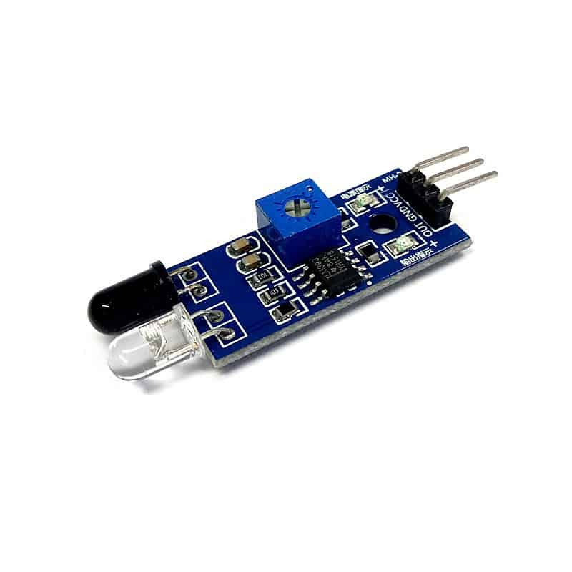
IR Reflective Sensor
Vcc | 3.3 to 5 Vdc Supply Input
GND | Ground Input
Out | The output that goes low when an obstacle is in range
Power LED | Illuminates when power is applied
Obstacle LED | Illuminates when an obstacle is detected
IR Emitter | Infrared emitter LED
IR Receiver | The infrared receiver that receives signal transmitted by Infrared emitter.

Slide 8
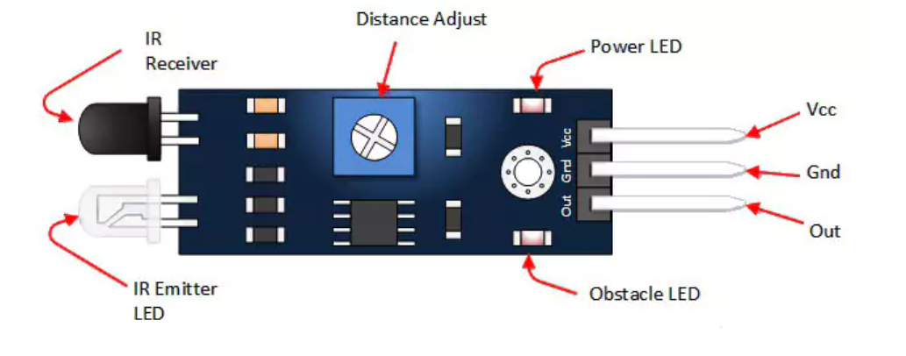

Slide 9
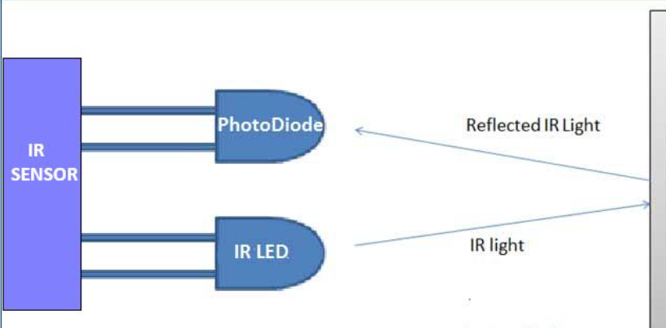
IR Reflective Sensor
How it Works?!!
An IR sensor consists of two parts, the emitter circuit, and the receiver circuit. The emitter is an IR LED and the detector is an IR photodiode.
The IR photodiode is sensitive to the IR light emitted by an IR LED.
The photodiode’s resistance and output voltage change in proportion to the IR light received. This is the underlying working principle of the IR sensor.
The type of incidence can be direct incidence or indirect incidence.
In direct incidence, the IR LED is placed in front of a photodiode with no obstacle.
In indirect incidence, both the diodes are placed side by side with an opaque object in front of the sensor. The light from the IR LED hits the opaque surface and reflects back to the photodiode.
Once the IR outputs the signal a 1 is outputted on the out port until it reads the reflected signal it changes to 0.

Slide 10
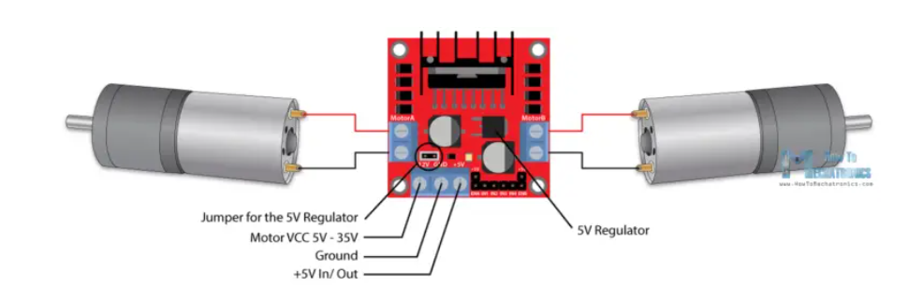
L298N motor driver
The L298N motor driver is a component used to control the speed and direction of two DC motors. It is based on a dual H-Bridge configuration and can handle voltages from 5V to 35V and currents up to 2A per channel.
Key Points:
Dual H-Bridge: Controls two DC motors independently
Voltage and Current: Operates with 5-35V and up to 2A per channel.
Control Pins:
ENA and ENB: Enable pins for motor channels, used for speed control via PWM.
IN1, IN2, IN3, IN4: Direction control pins.
Outputs: Four output pins (OUT1, OUT2, OUT3, OUT4) to connect motors.

